Slide 1
KNK ERP Finance Data Issues(2020)

Slide 2
General Overview
On Analysis of the KOKO Networks Kenya ERP, we have found several data issues within the system that will directly impact KOKO Networks Kenya’s Financial Audit for 2021 (And the interim Audit in October 2020). The issues discovered cut across the system relevant to the following:
Accounting
Inventory

Slide 3
Accounting Data Issues (A/P)
Vendor Bills (Supplier Invoices)
Created Total in 2020 - 9810 Invoices
Open Invoices - 8677 Invoices (Validated but not paid in the ERP) Amounting to KES 195,017,077.07 (Not paid in the system / reconciled, may have been paid through the bank and Payments recorded Separately)
Open Invoices for Agents - 8114 Invoices Amounting to KES 15,258,816.41
Open Invoices for Other Suppliers / Vendors - 563 Invoices Amounting to KES 179, 758,260.66
Note:
Payments for most of these invoices are might be recorded in the System directly in a consolidated manner, But as they are not post for the specific Agents, we can not reconcile them with the Invoices.
As these reconciliation is not done and Invoices are in Open State the Account Payable is not reduced..

Slide 4
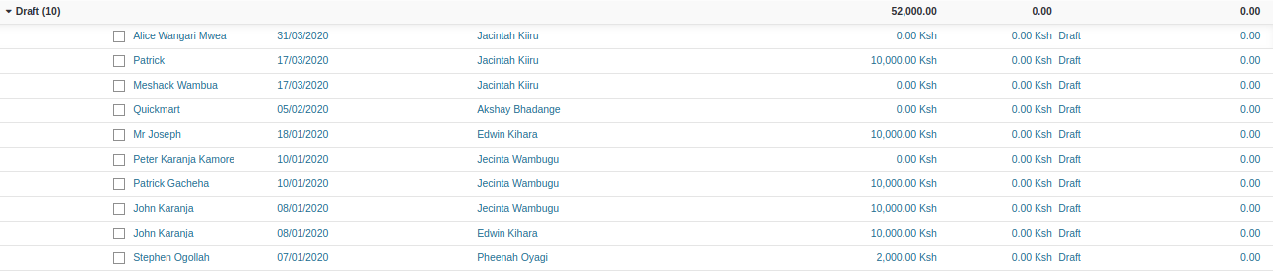
Accounting Data Issues (A/R)
Customer Bills (Receivable Invoices)
Created Total in 2020 - 281846 Invoices
Draft Invoices - 41085 Invoices (no financial impact on system)
41075 Invoices are Fuel Invoices(will be processed in Oct 2020 Fuel Invoices)
10 Invoices Needs Explanation (Looks like Agent Security Deposit invoices but not processed)

Slide 5
Accounting Data Issues (A/R)
Customer Bills (Receivable Invoices)
Open Invoices - 384 Invoices (Validated, Journal Entry impact but no reconciliation, VIVO KNTPUF Invoices) Total Amounting to KES 6,478,670.90
Rest Invoice are paid

Slide 6
Shop Monthly Statements Corrections
There is an issue with the shop monthly statements created in the ERP system, due to unclear business requirements and set milestones from the sales team on the definition of an Agent and what milestones must be achieved to deem a shop / agent as payable.
Total Open Shop Payables - 6075 Amounting to KES 112,433,153.56
Period January 2020 - September 2020
3 Shop Monthly Statements are created for december 2020 need to investigate and correct.

Slide 7
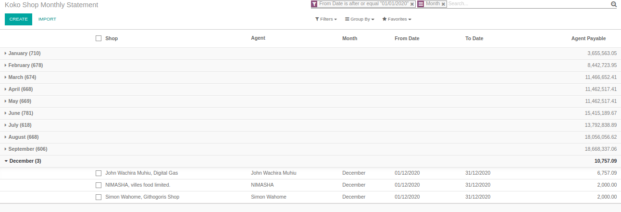
Shop Monthly Statements Corrections

Slide 8
Purchase Orders
Total Created Purchase Orders - 2020 (Billing Status shown below)
Nothing to Bill - 38 (The Goods Received Note has not been processed, leading to issues with stock valuation and accounting), Amounting to KES 34,469,710.68
Waiting Bills - 152 (The Invoices for these Purchase Orders have not been posted, payment may / may not created in the system), Amounting to KES 115,090,777.24
No bill to receive - 206 (Bills for the purchase Orders are created but 52 Vendor yet in Open state need to process. )
Total Created Purchase Orders - 2019 (Billing Status shown below)
Nothing to Bill - 19 (The Goods Received Note has not been processed, leading to issues with stock valuation and accounting), Amounting to KES 34,469,710.68
Waiting Bills - 422 (The Invoices for these Purchase Orders have not been posted, payment may / may not created in the system), Amounting to KES 115,090,777.24
No bill to receive - 521

Slide 9
Inventory Adjustments (Incoming Stock)
Total Adjustments to bring stock into the system 2020 (Incorrect method) - 2,483 [Though this number is relatively lower then 2019 but yet this number is quite high ]
January 2020 - 1566
February 2020 - 47
March - 13
April - 13
May - 327
June - 174
July - 271
August - 65
September - 7

Slide 10
Proposed Solution
Data Clean Up
Team Responsibility Matrix
Drive User Adoption

Slide 11
Data Clean Up
Allocate resource to clean the Accounting Transactions for 2020
Allocate resource to clean Shop Statements for 2020
Allocate Finance resources to clean the Purchase Order / Receipts / Vendor Bills for 2019 and 2020
Validate Trial Balance for 2020
Validate P&L Account for 2020
Validate Aged Payables for 2020
Validate Partner Closing Balance 2020
Data Clean up steps are as below : https://docs.google.com/document/d/1d1m0WBfGK921pKuTXyBv0zOF4R-J6iJf8pAzdOQvXuk/edit?usp=sharing
Estimated Time : 5 - 7 Weeks
Resources:
1 Full time Intern [As discussed with Finance team]
1 Developer / PM resource to train the Intern on Odoo [3 - 4 Hours] more guidance as required
1 Developer and PM [with a Finance team member] to Overview the progress and make sure the process is executed Correctly.

Slide 12
Team Responsibility Matrix
Objective:
Clearly define user roles & responsibility
Clearly define KPI’s and Reports for Senior Managers
Senior Managers to take ownership of teams performance and monitor tasks
Drive Transparency across business functions
Enable a proactive way of working to clear audit objectives (Internal & External)

Slide 13
Drive User Adoption
Users should continually monitor and manage the system raising key problems or pain points in time for quick resolution.
Better User Acceptance Testing plans.
Implementation of an ERP Manager (Business) to ensure that data is entered into the system and is up to date
Focus on building centralized ERP Team to focus on ERP management, user support and troubleshooting (while Engineers and Product Managers focus on new requirements)

Slide 14
Proposed Responsibility Matrix KNK ( X-Business)
Sr. No. | Department | Responsible | Expected completion Date | Coordinator - L1 | Support Lead
1. | Store Inventory [BD] | Peter | Oct 23, 2020 | Peter
2. | Store Inventory [Premier] | Peter | Oct 23, 2020 | Peter
3. | Purchase Invoices | Doreen / Mitchel | Oct 30, 2020 | Madhav
4. | Purchase Payments | Doreen | Oct 30, 2020 | Madhav
5. | Sales / Agent Deposit Invoices and Payments | James | Oct 30, 2020 | Madhav
6. | Vendor Invoices / Payments | Mitchel/Innocent | Oct 23 ,2020 | Madhav
7. | Shop monthly Statement Cleanup and Review | Intern / Akshay / Madhav |  | Akshay | Madhav
8. | Accounting Reports Validation | Smit / Madhav | Nov 16, 2020 | Madhav

Slide 15
Audit Risk
Incorrect Financial Recording, leading to poor visibility on:
Payables
Receivables
Tax
Trial Balance
Profit & Loss
Balance Sheet
Stock Valuation
Partner Ledgers
Bank Reconciliation
Cash Flow

Slide 16
Thank You!!
For more clarity contact:
Madhav Agarwal

